Slide 1

PROJECT TITLE
BLEUCT1003
Creativity, Innovation and Entrepreneurship & IPR
Team Leader Detail:
Name :Aviral Gaurav
Enrollment No: 21SCSE1300029
Section:24
Mentor. ANAS ABBAS
Email:
Phone:
Team Members Detail:
1. ABHINAV KUMAR CHOUDHARY(21SCSE1011615)
2. AMIT SINGH(21SCSE1410106)
3. DEEPANSH BHATIA(21SCSE1011677)
4. NEERAJ SINGH(21SCSE1011675)
5 AVIRAL GAURAV(21SCSE1300029)
6. ASHUTOSH RAI(21SCSE21SCSE1011691)
Semester: II Section:24
Session 2021-2022

Slide 2
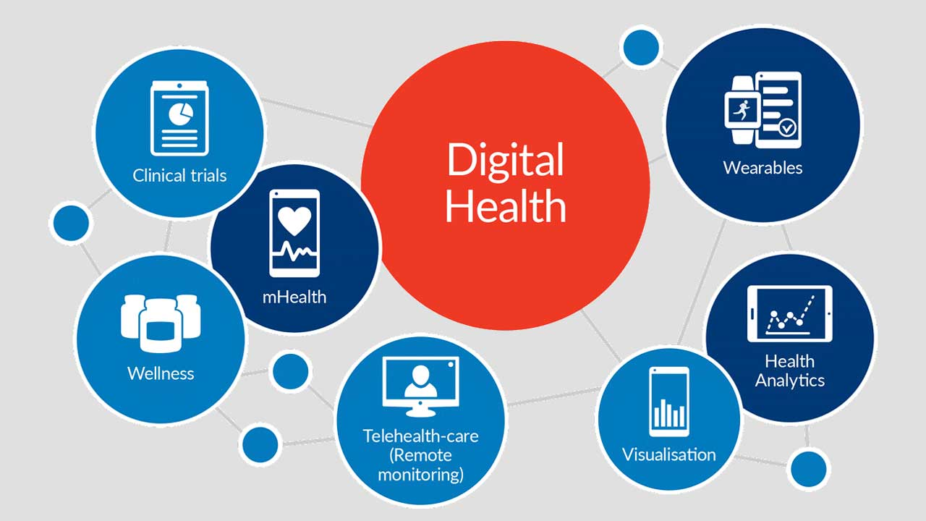

Slide 3
INTRODUCTION
e-Health care e-health, also spelled eHealth, also called e-health care, use of digital technologies and telecommunications, such as computers, the Internet, and mobile devices, to facilitate health improvement and health care services. E-health is often used alongside traditional “off-line” (non-digital) approaches for the delivery of information directed to the patient and the health care consumer.

Slide 4
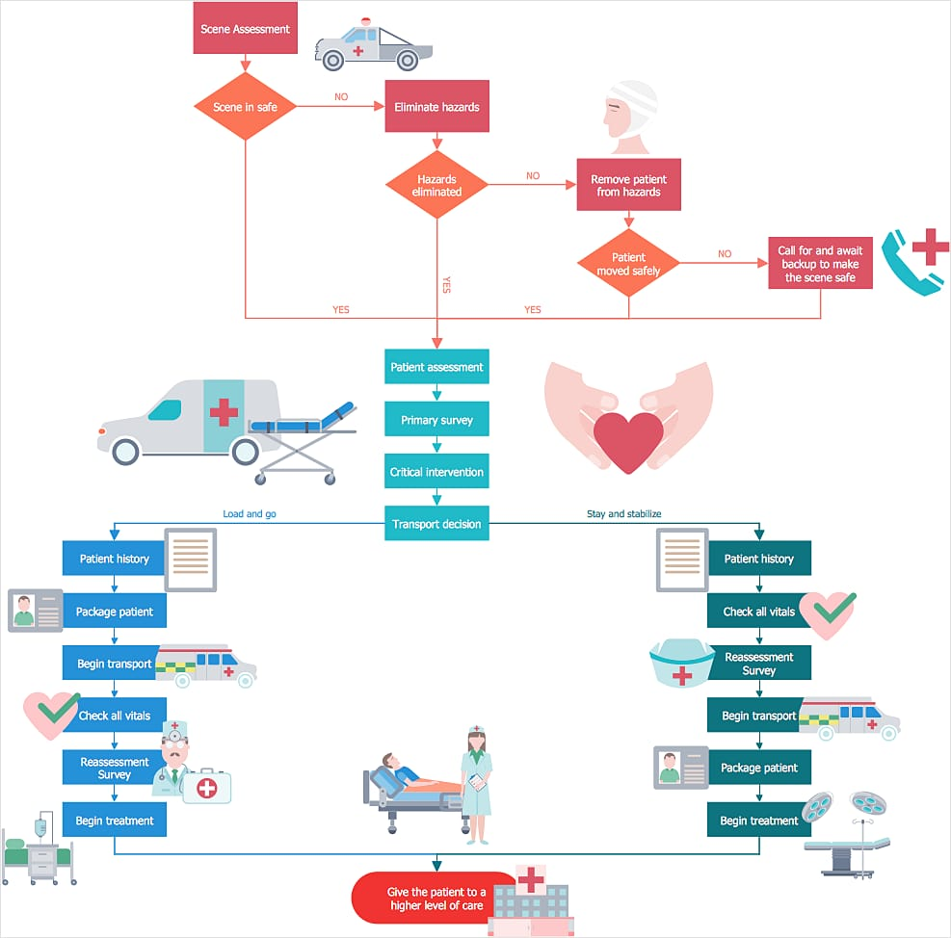
BLOCK
DIAGRAM

Slide 5
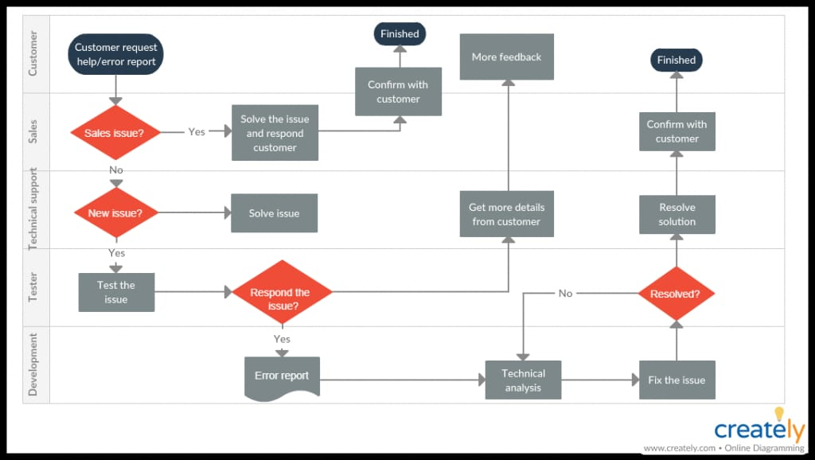
CUSTOMER CARE

Slide 6
EXISTING SYSTEM
e-Health care e-health, also spelled eHealth, also called e-health care, use of digital technologies and telecommunications, such as computers, the Internet, and mobile devices, to facilitate health improvement and health care services. E-health is often used alongside traditional “off-line” (non-digital) approaches for the delivery of information directed to the patient and the health care consumer.

Slide 7
Market Survey on Project
The healthcare apps market is dominated by small and medium-sized start-ups that are trying to expand their reach further. In terms of revenue, the market in India was valued at INR 43.41 Bn in 2020. It is estimated to reach INR 337.89 Bn by 2026, expanding at a CAG Report of ~39.37% during the 2021-2026 period. Digital transformation, coupled with substantial support from the government, has aided the growth of the healthcare apps market in India. The digital footprint of the country has been strengthened by a swift growth in the number of mobile subscribers and Internet users in the country. The number of smartphone adopted was 810 million in 2020 and is expected to surpass 1.2 billion by 2026. The market has faced significant challenges due to lack of awareness, security issues, and unsatisfactory app performance. Moreover, for most consumers, fitness and wellness management are the areas of primary concern. They are unaware about the types of healthcare apps that are available for various health issues.

Slide 8
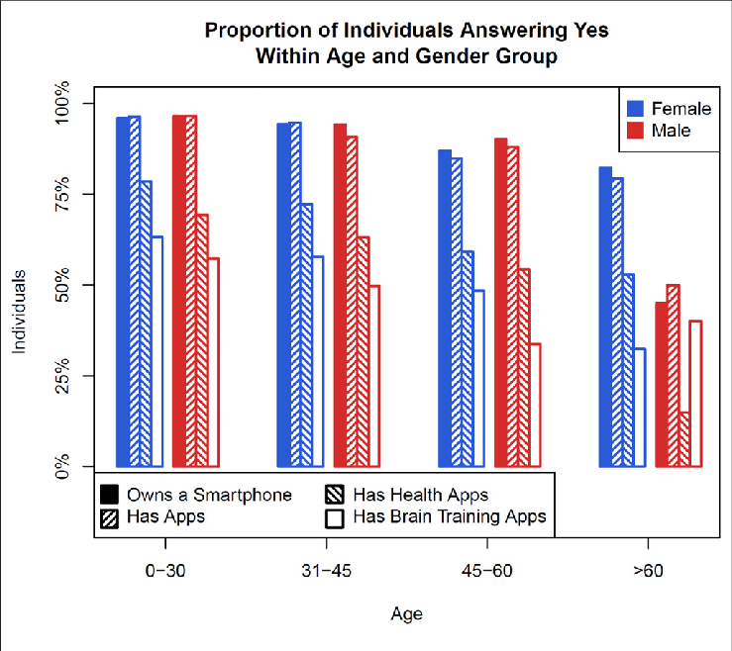

Slide 9
Flaws in Existing Market
The main weak point of the modern health system that doctors and health officials also worried : Data privacy :Many health apps raise data privacy concerns. In 2013, Privacy Rights Clearinghouse, a nonprofit advocacy organization in San Francisco, analyzed 43 free and paid apps, finding that 72 percent of them leaked their personal information such as dates of birth, email addresses, and medical information. Only half of the apps linked to a privacy policy, which typically explains what personal information is gathered and if data is shared with or sold to third parties. Inaccurate information : Some apps claim to be able to measure a user's heart rate and stress levels using a sensor beneath the phone's camera. Others claim to be able to measure blood pressure using the phone's screen or camera. Lack of regulation and approval. A study published in the Journal of the American Society of Hypertension found that only 3 percent of the top 107 apps found using the terms "hypertension" and "high blood pressure" were developed by health care agencies .

Slide 10
Proposed Plan
Increase Awareness towards health Generate Health Report Not need to visit Hospitals for normal issues Doorstep service for General Tests Providing Medicines at your doorstep Medical Insurance

Slide 11
Project Plan/ Duration (Time line)
Sr. No. | Activity /Objective | Duration
1. | Sponsor | As soon as possible
2. | Development of Website | 10 days
3. | Searching Employees | Soon
4. | Market Survey | 1 month
5. | Advertisement | 2 month

Slide 12
Proposed Budget
Sr. No. | Item | Quantity | Rate | Amount
1. | Web Development | 1 |  | Rs. 10000
2. | Office Setup | 1 |  | Rs. 50000
3. | Survey & Advertisement |  |  | Rs. 20000
4. | Employees | 6 |  | Rs. 20000
Grand Total |  |  | Rs. 100000

Slide 13
Website
GitHub Link: https://github.com/neeraj46665/E-health-website/tree/main/img Website Link: https://neeraj46665.github.io/E-health-website/

Slide 14


Website Prototype

Slide 15
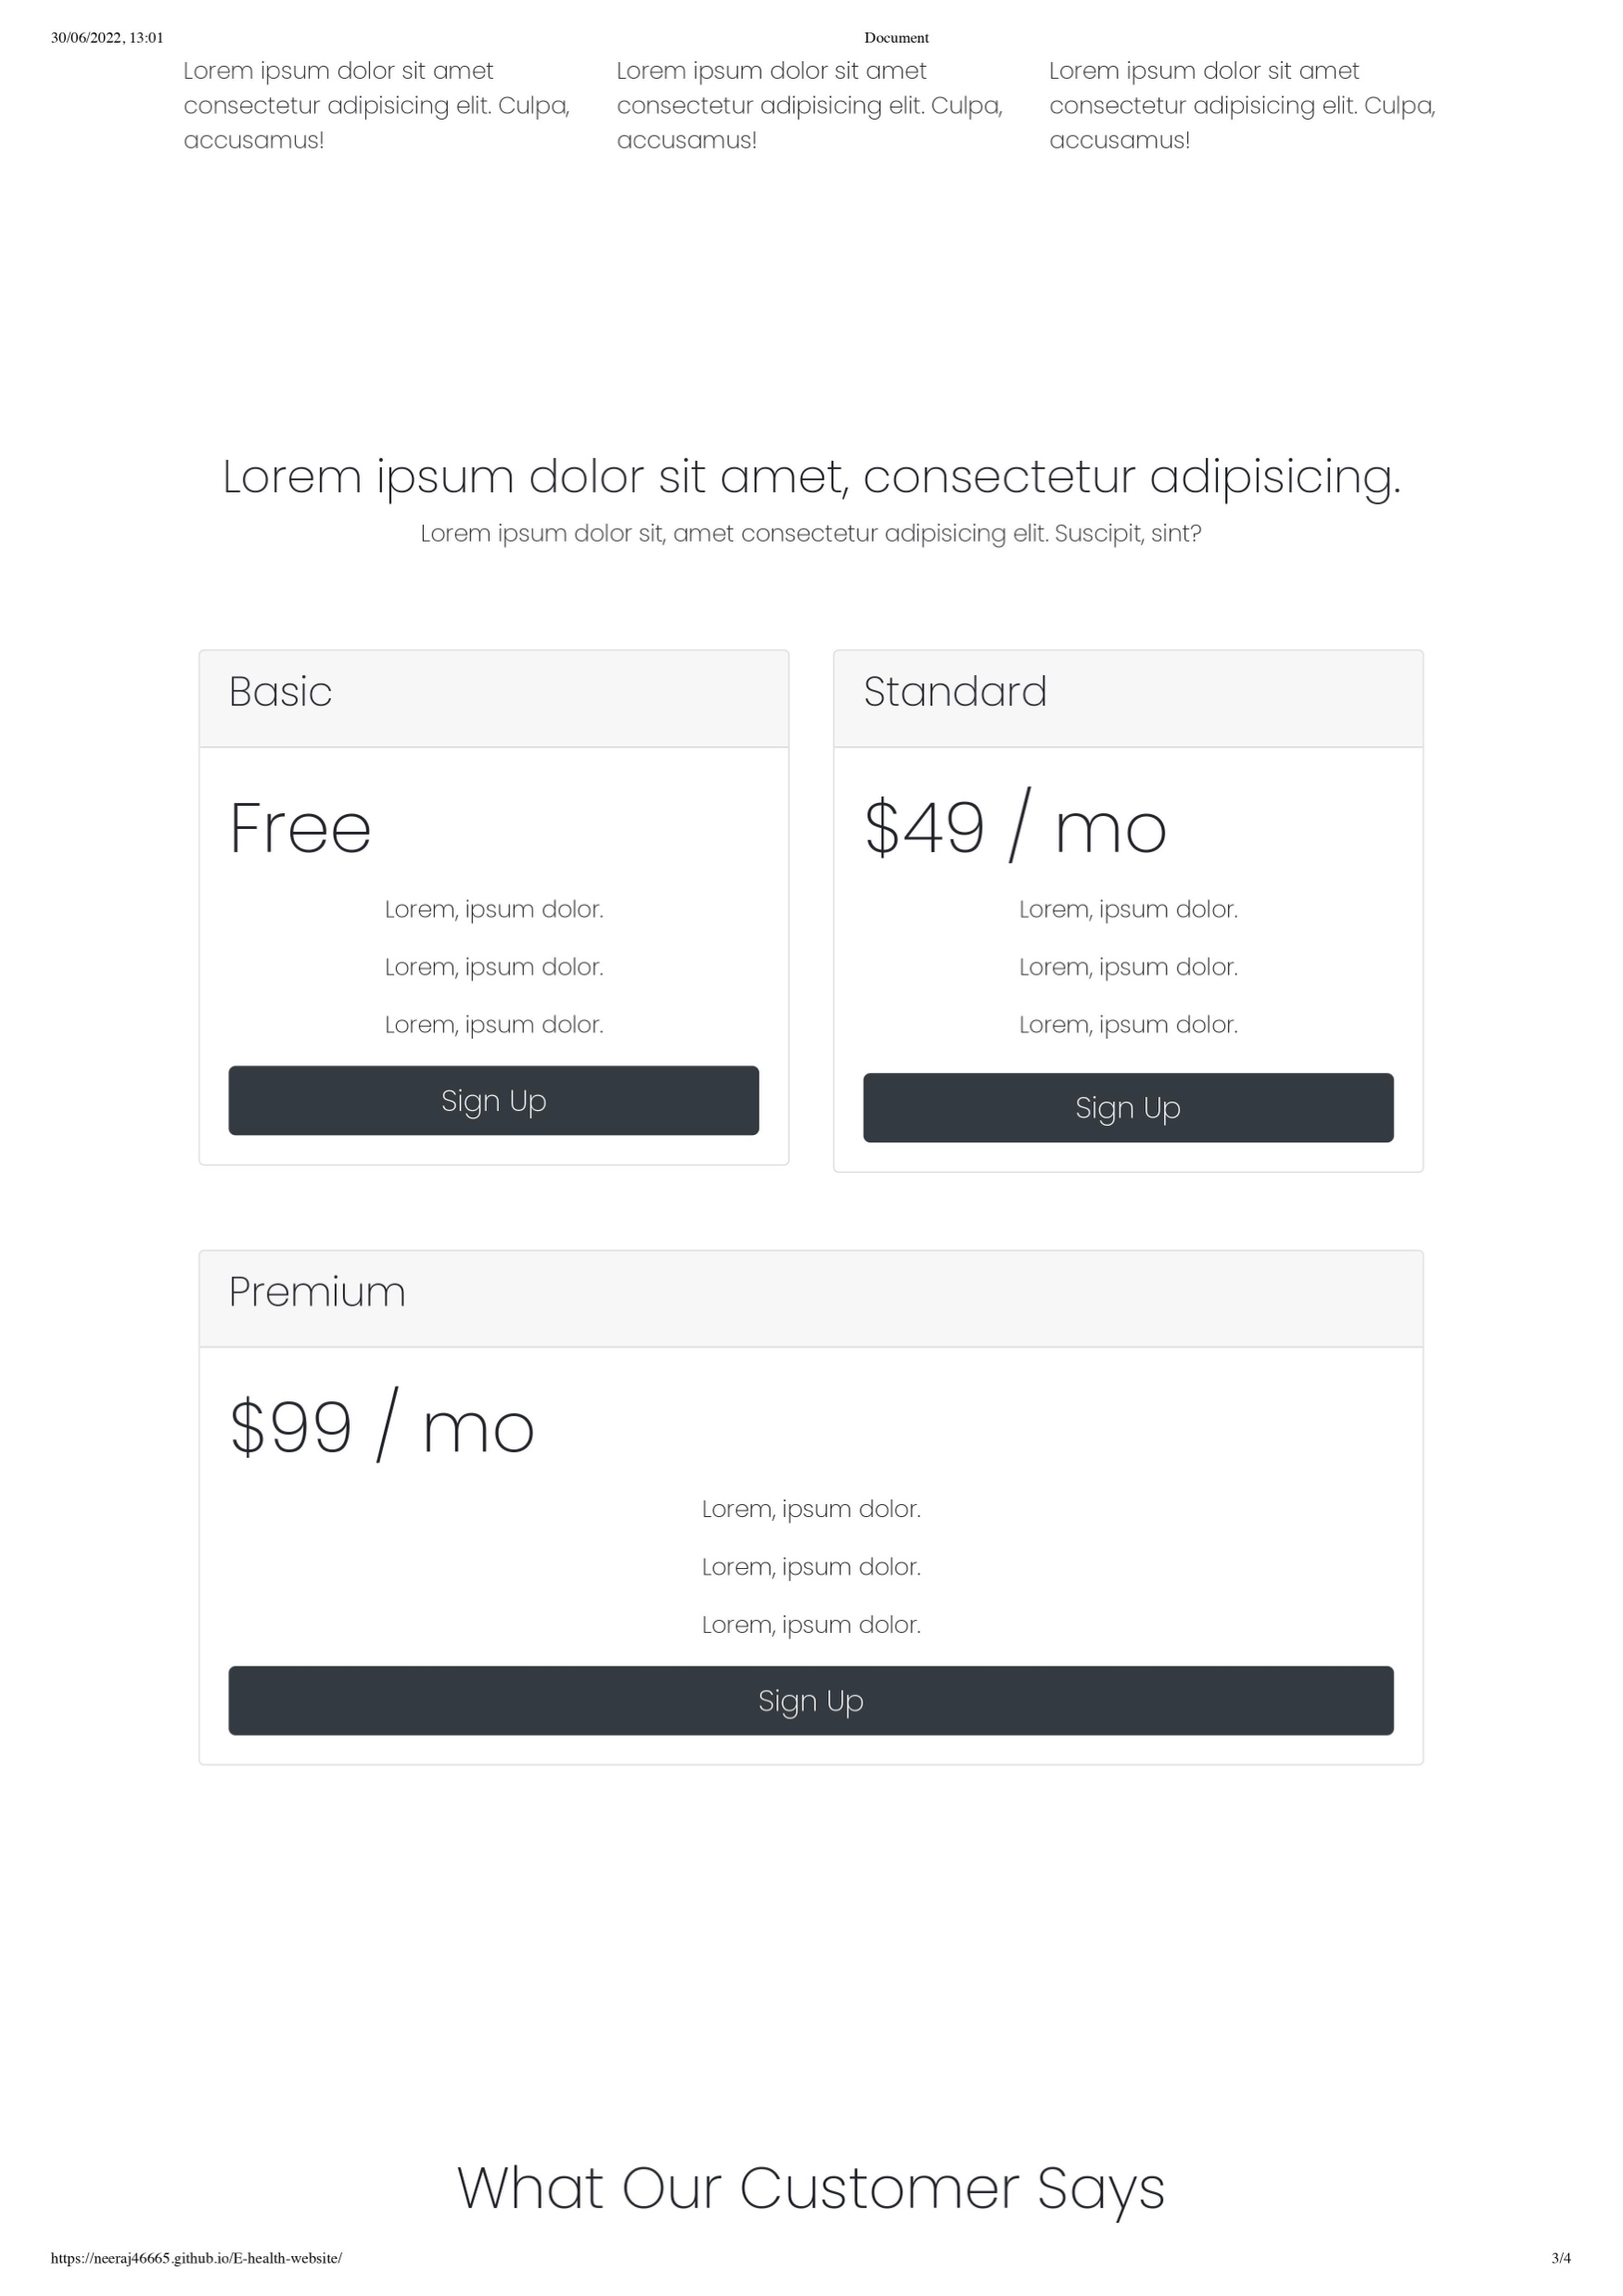


Slide 16
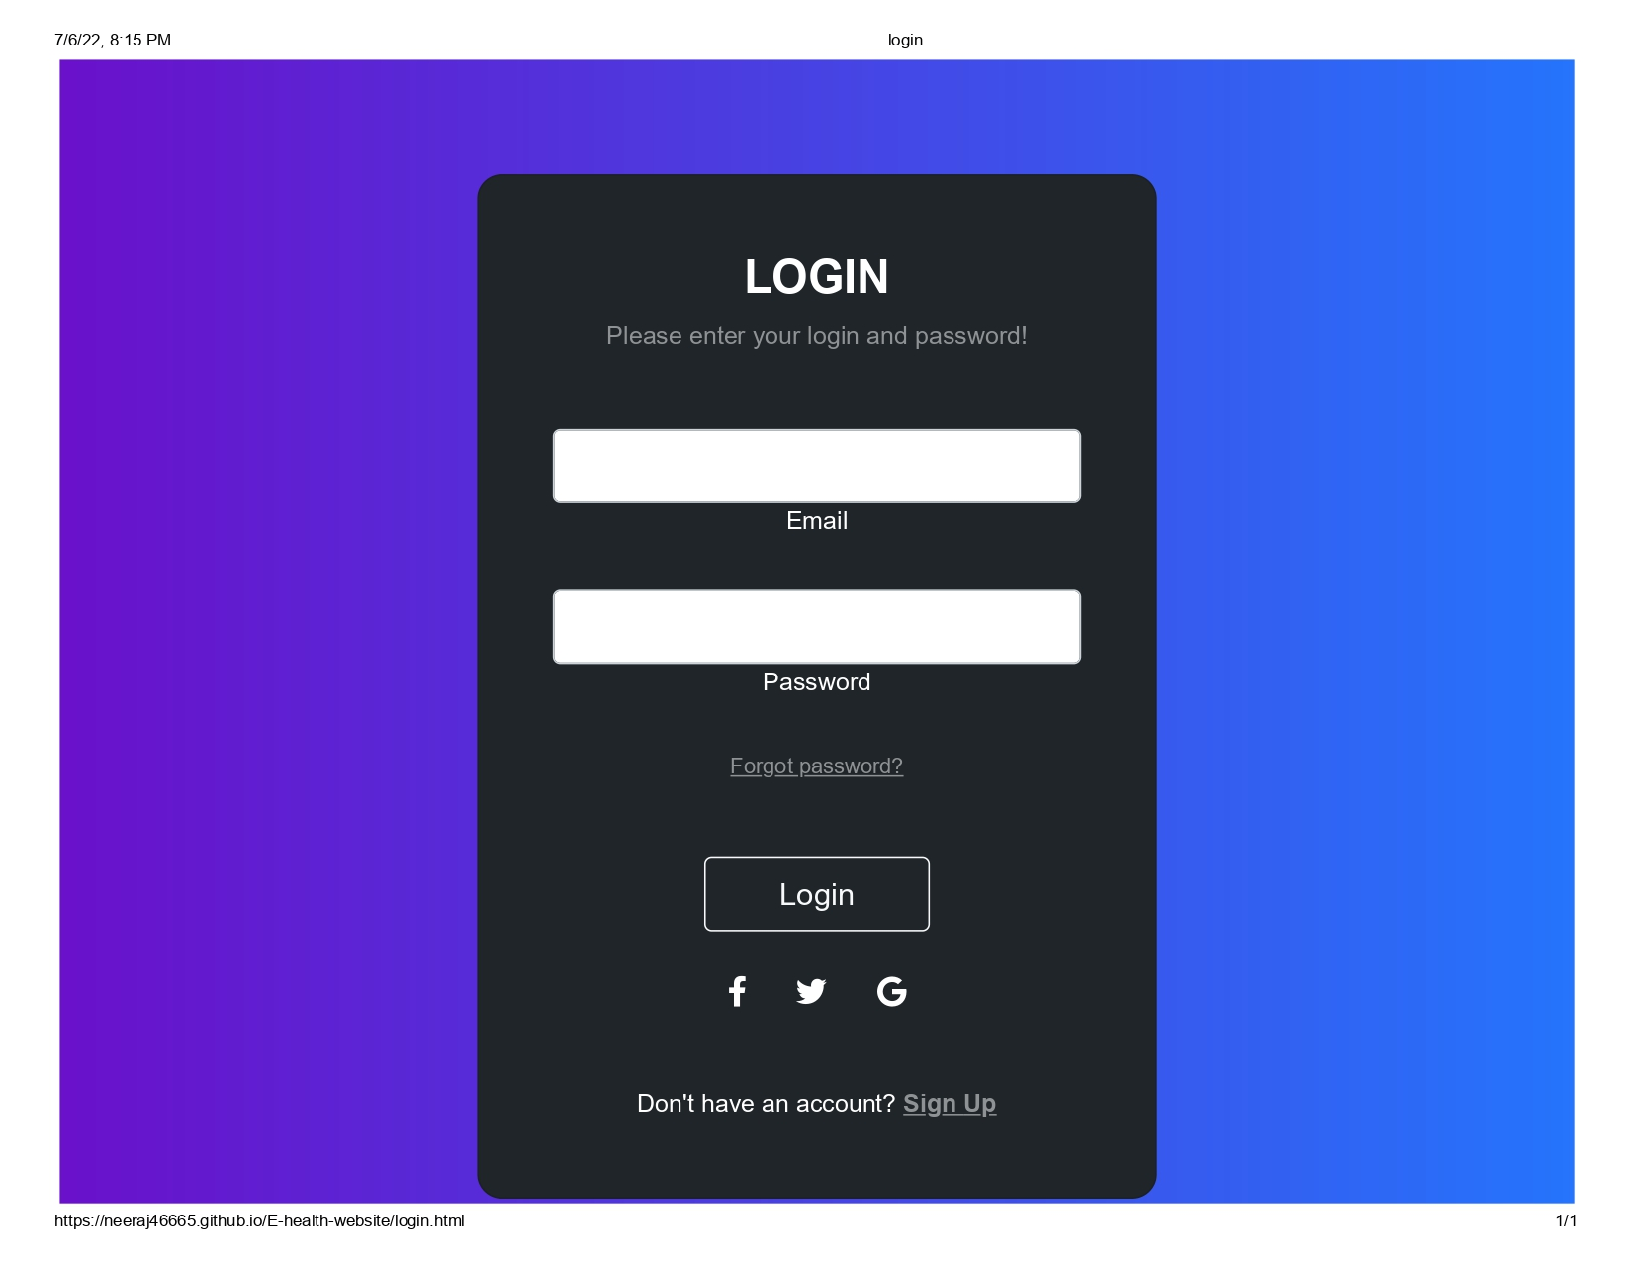
Login Page

Slide 17
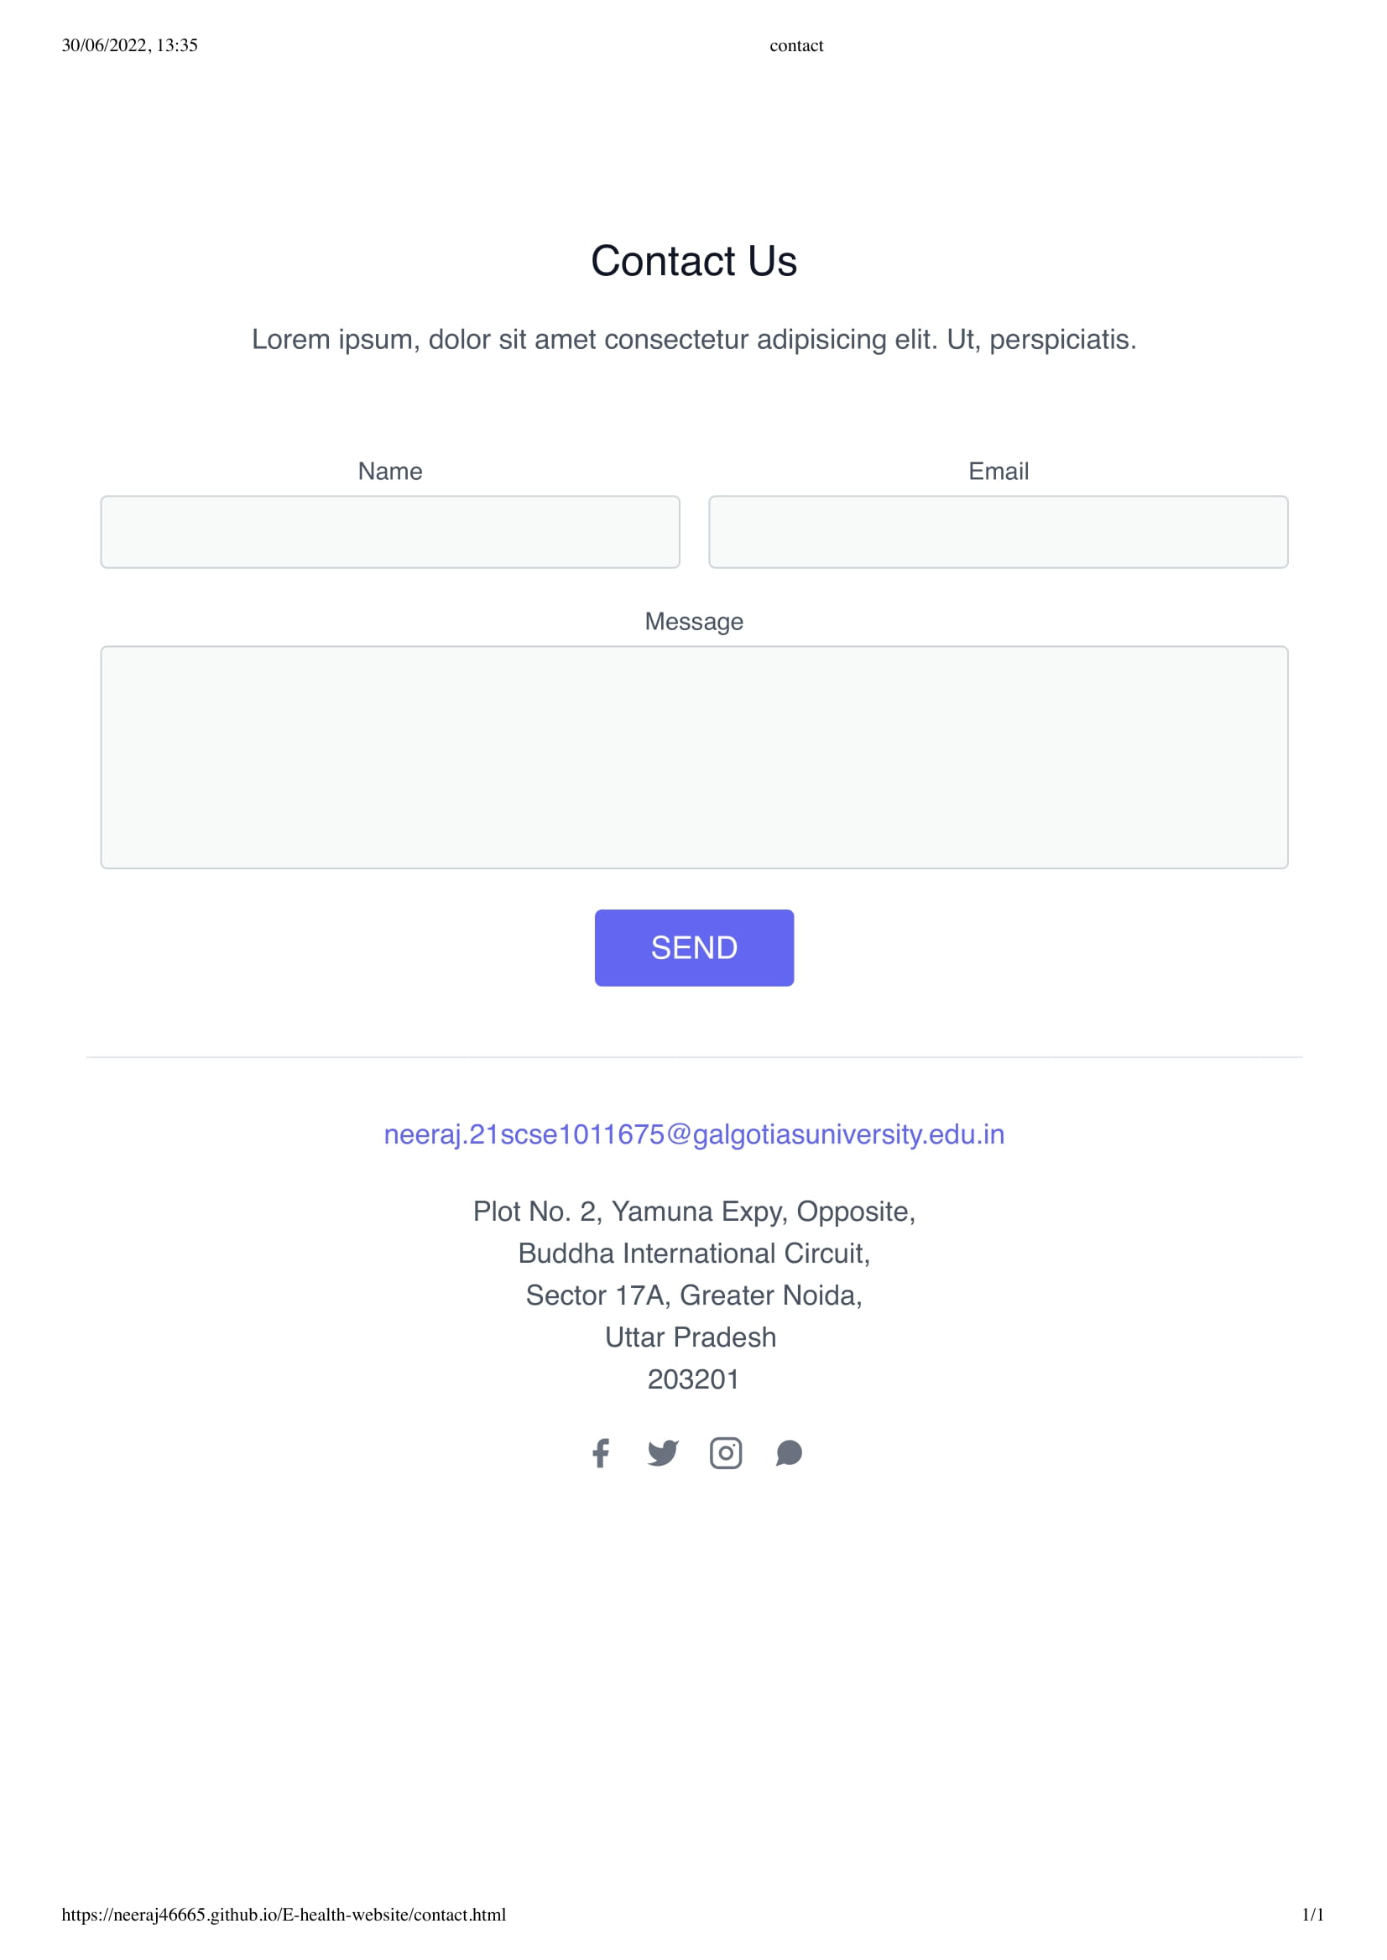
Contact Page

Slide 18
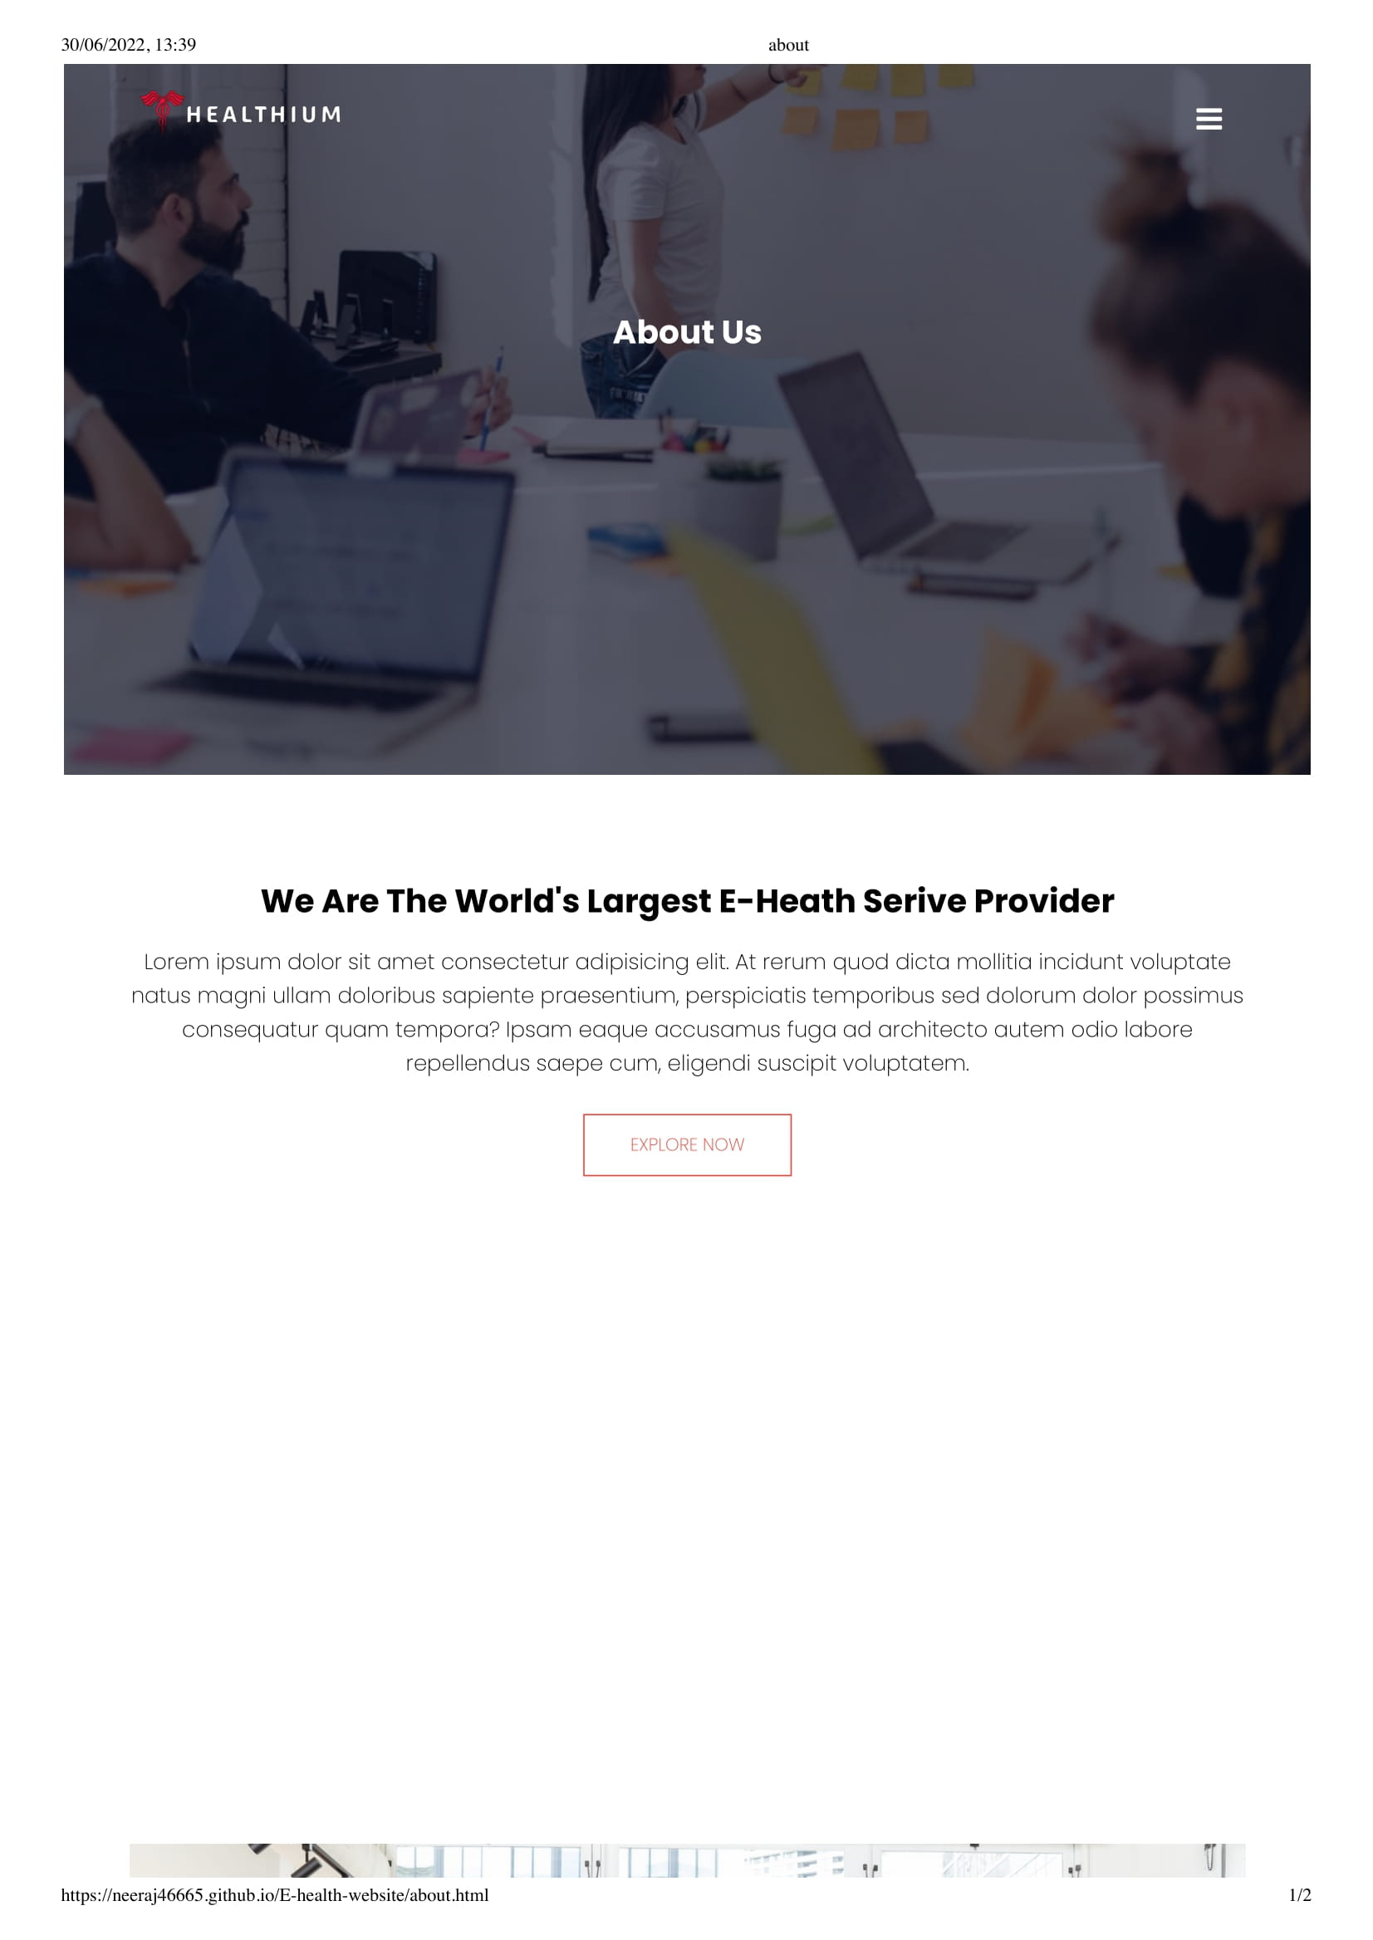

About Us Page

Slide 19


